Slide 1

Bengaluru– 560 038, Karnataka, INDIA
Presentation on
RATING PREDICTION FOR REVIEWS
Submitted by:
ADITI GUPTA
Internal Guide
KHUSBOO GARG
SME
Flip Robo Technologies
PGP Instructor
Dr. Deepika Sharma
Training Head
DataTrained

Slide 2
Contents
Problem statement
Data Collection
Hardware and Software Used
Data Preprocessing
EDA
Building Word Dictionary
Model Training
Key Metrics
Hyperparameter Tuning
Best Model
Saving and testing the Model
Conclusion

Slide 3
Problem Statement
We have a client who has a website where people write different reviews for technical products. Now they are adding a new feature to their website i.e. The reviewer will have to add stars(rating) as well with the review. The rating is out 5 stars and it only has 5 options available 1 star, 2 stars, 3 stars, 4 stars, 5 stars. Now they want to predict ratings for the reviews which were written in the past and they don’t have a rating. So, we have to build an application which can predict the rating by seeing the review.

Slide 4
DATA COLLECTION

Slide 5
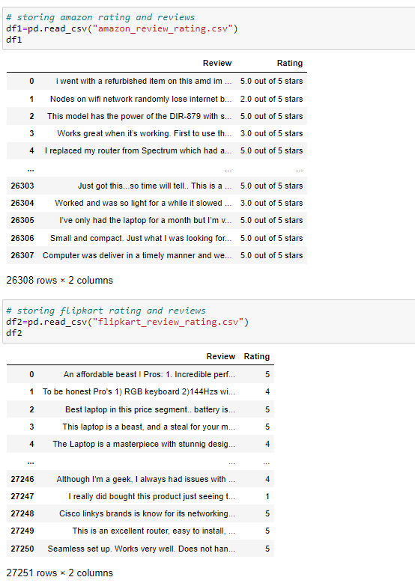
Data Source and their Formats
Reviews and ratings for various technical products were collected from various ecommerce websites like Flipkart and Amazon. The scrapper was written in Python programming language using the Selenium package.
The reviews were stored in csv format. I scrapped reviews and ratings of 9 products for 20 pages so from amazon I got 26308 ratings and reviews and from flipkart I got 27251 ratings and reviews in total which I saved in 2 different csvs.

Slide 6

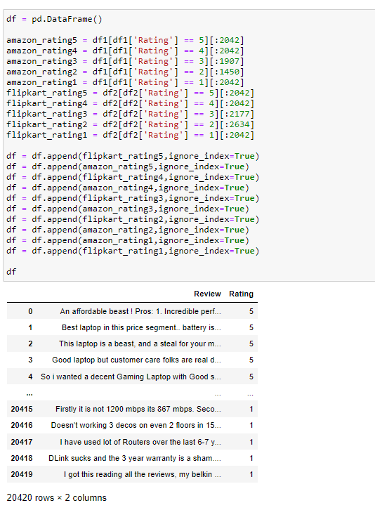
I noticed that ratings datatypes are different in both amazon has ratings in object type as “4.0 out of 5” and in flipkart it is like “4”…so I have done some data cleaning by removing the “out of 5” from amazon csv and converting that column into int format.
In order to have a balanced dataset, reviews with equal count of ratings were chosen from the two datasets and made a new dataset called df which contains 20420 total reviews and ratings with 4084 count of each.

Slide 7
Final DataSet

Slide 8
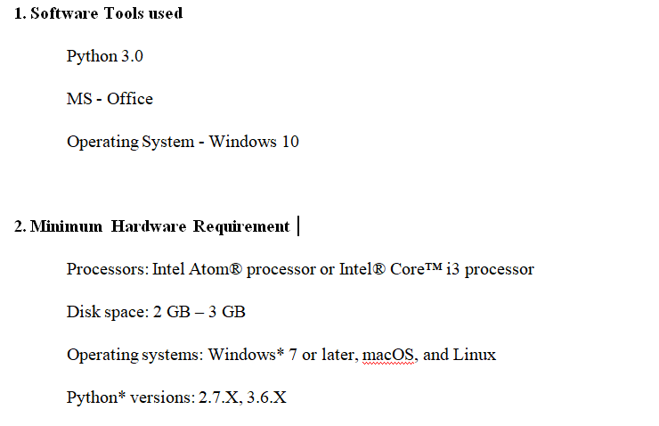
Hardware and Software Requirements and Tools Used

Slide 9
DATA PREPROCESSING

Slide 10
DATA PREPROCESSING STEPS
Convert all letters to lower/upper case
Removing numbers
Removing punctuation
Removing white spaces
Removing hyperlink
Removing stop words
Removing Short words (length<=3)
Word lemmatization
Adding 3 new columns (Review_length,Clean_review,Clean_review_length)
Vectorisation (Using Tf/idf)

Slide 11
EXPLODATORY DATA ANALYSIS

Slide 12
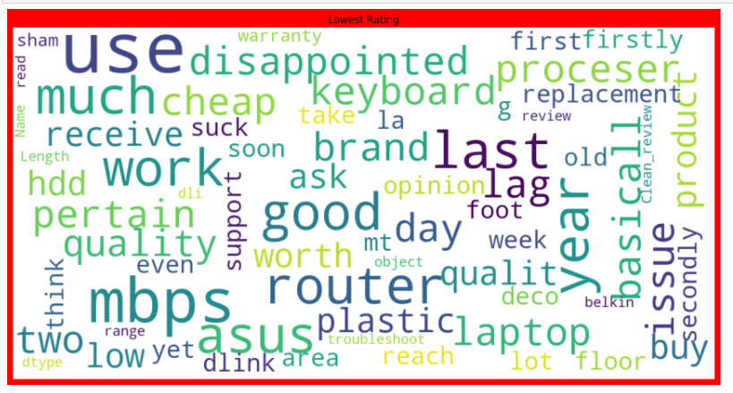
Word Cloud for Rating=1

Slide 13
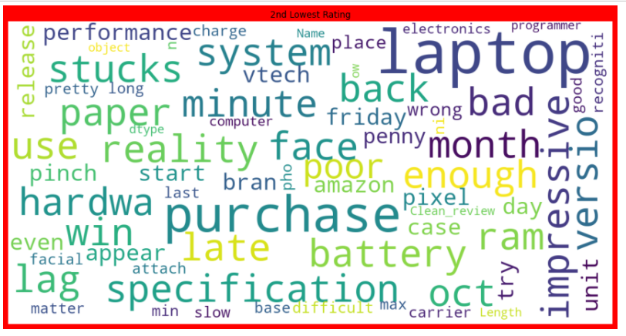
Word Cloud for Rating=2

Slide 14
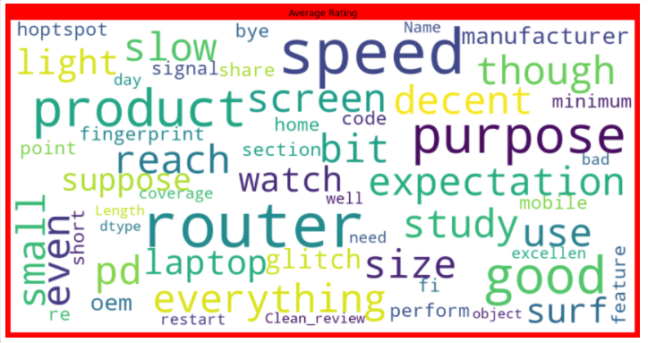
Word Cloud for Rating=3

Slide 15
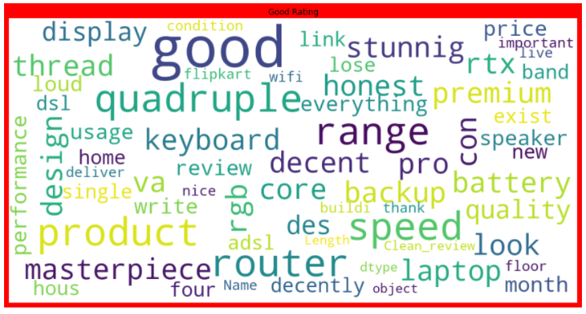
Word Cloud for Rating=4

Slide 16
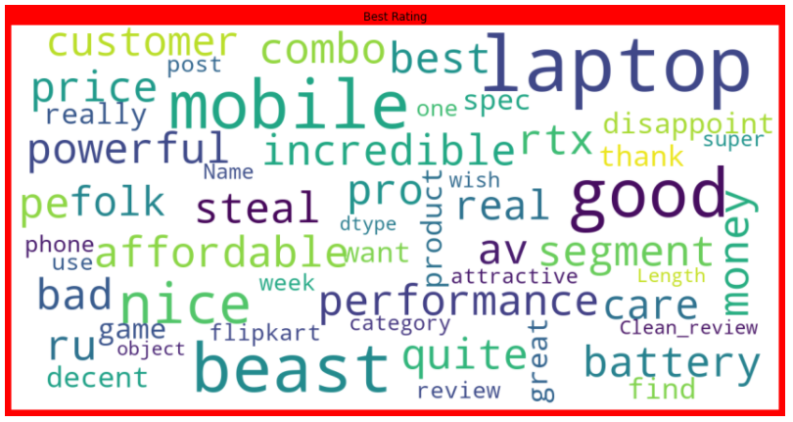
Word Cloud for Rating=5

Slide 17
BUILDING WORD DICTIONARY

Slide 18
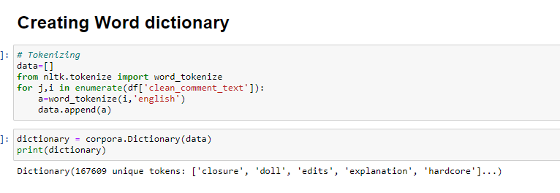
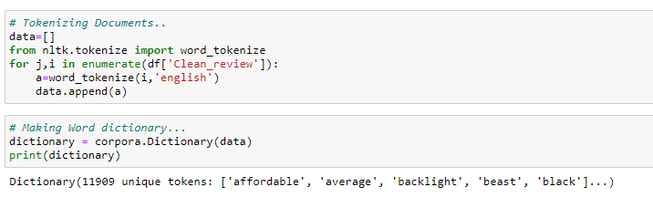

Slide 19
MODEL TRAINING

Slide 20
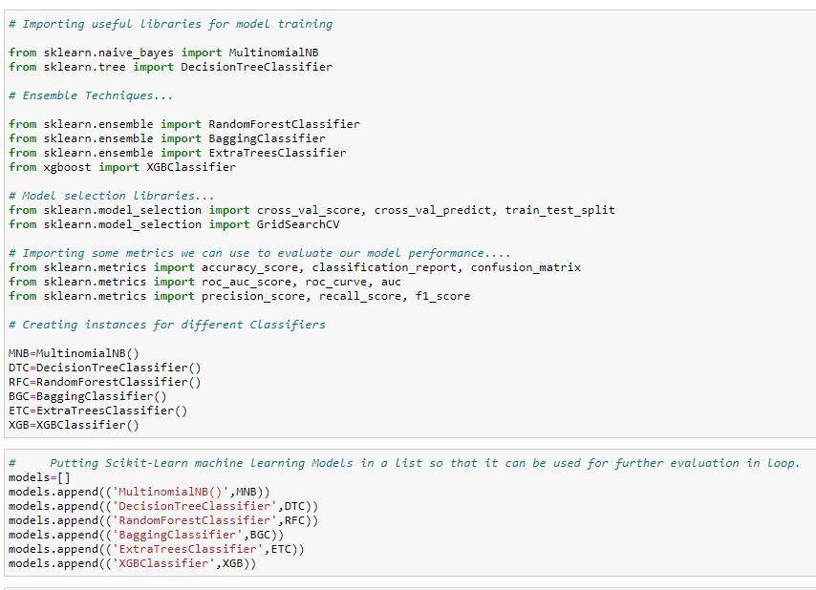
Model/s Development and Evaluation
From the given dataset it can be concluded that it is a Classification problem as the output column “label” has binary output “0 & 1”. So for further analysis of the problem we have to import or call out the Classification related libraries in Python work frame.

Slide 21
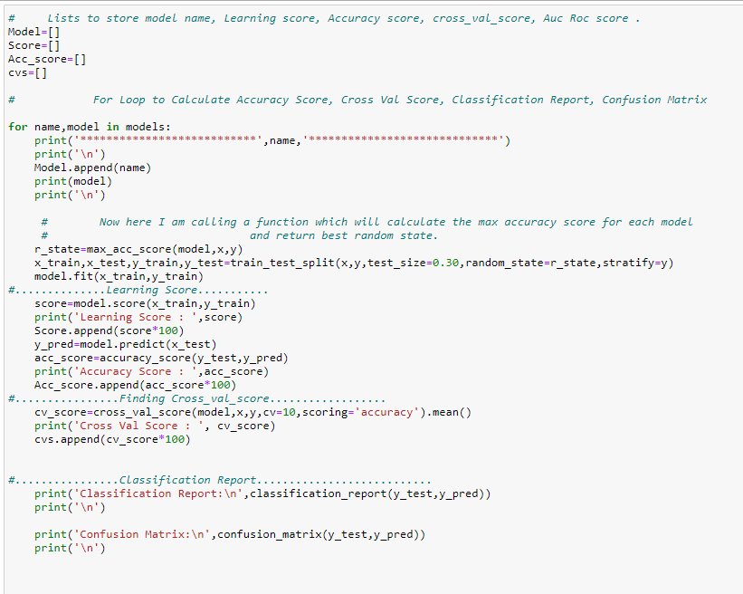

Slide 22
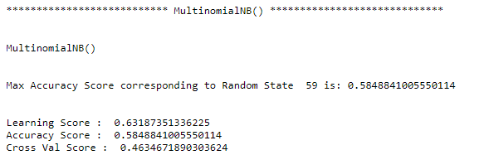
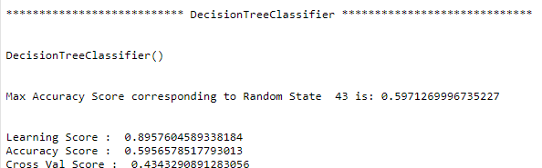
MultinomialNB
DecisionTree Classifier

Slide 23
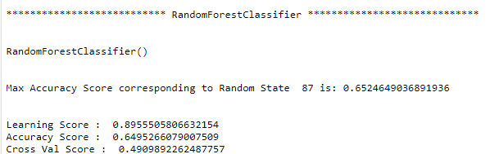
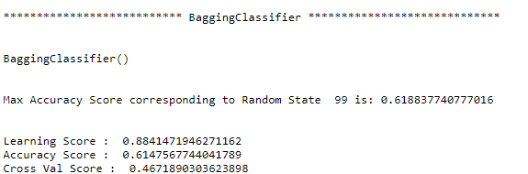
Random Forest Classifier
Bagging Classifier

Slide 24
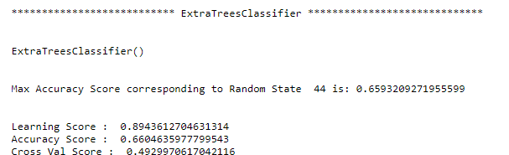
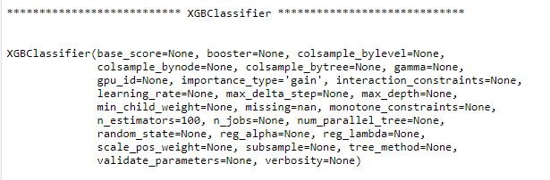
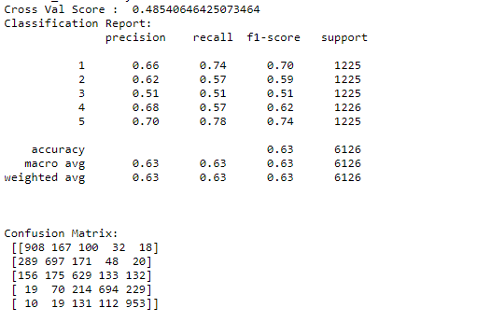
ExtraTrees Classifier
XGB Classifier

Slide 25
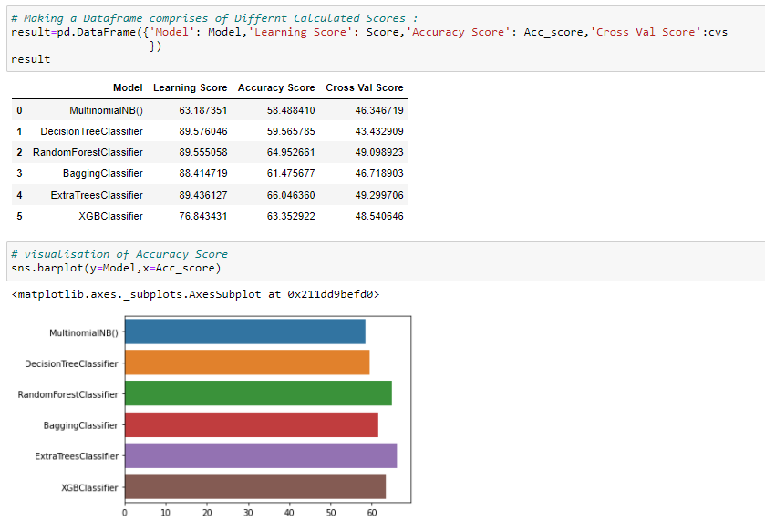
Key Metrics for success

Slide 26
HYPERPARAMETER TUNING

Slide 27
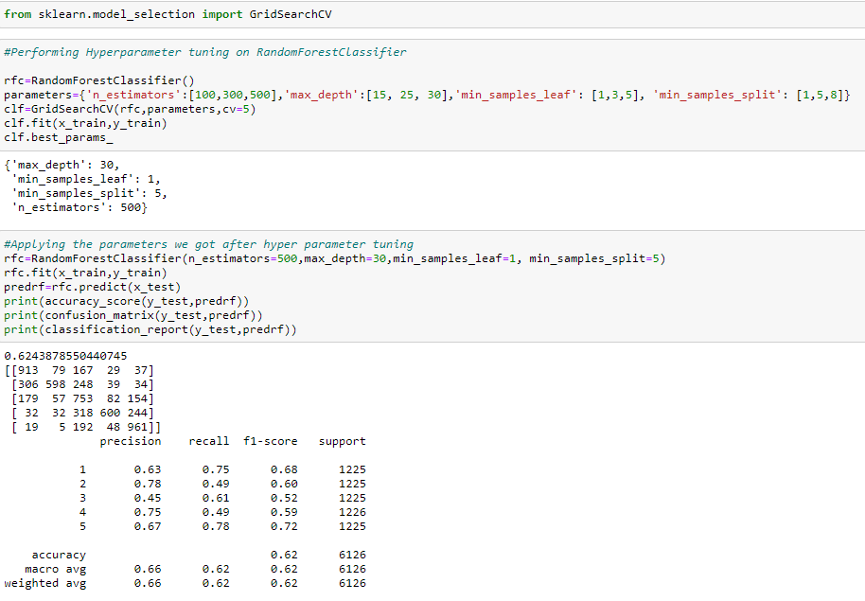
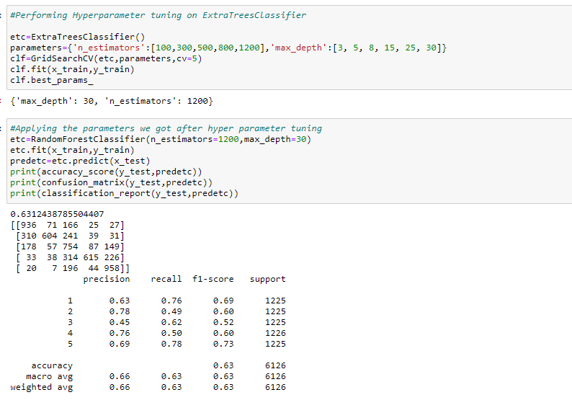
GridSearch CV
Grid search is an approach to hyper parameter tuning that will methodically build and evaluate a model for each combination of algorithm parameters specified in a grid.

Slide 28
Applying results of GridSearchCV

Slide 29
BEST MODEL

Slide 30
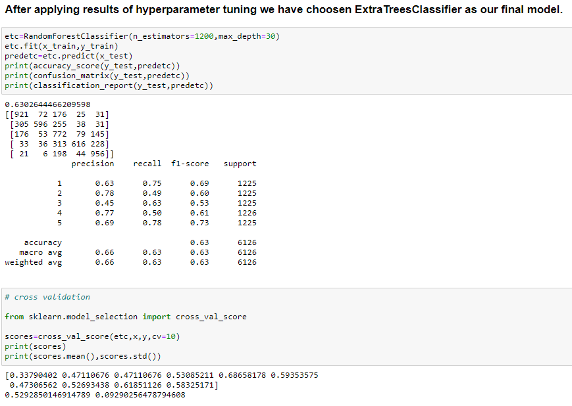
Choosing Best Model
The ExtraTrees Classifier is working best and can be considered as finalised model.

Slide 31
Saving And Testing
our Model

Slide 32
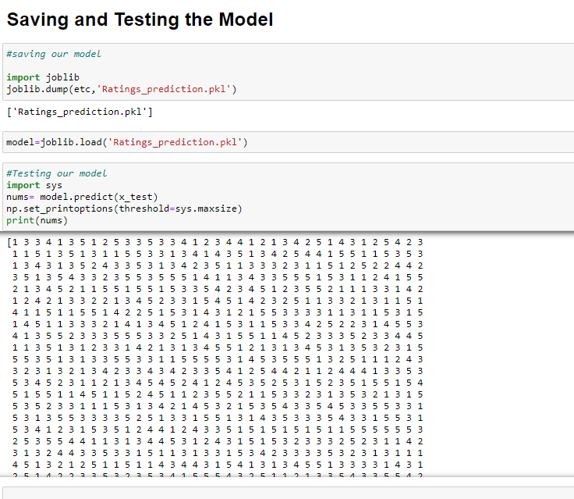

Slide 33
CONCLUSION

Slide 34
Key Findings and Conclusions of the Study
After all the process used in Natural Language Processing has been applied on our dataset, our model is able to predict ratings with an accuracy of 63% with Extra trees classifier.
Learning Outcomes of the Study in respect of Data Science
For any given dataset, the EDA process is extremely important as well as beneficial in order to build an effective model. Visualizations help us to analyze the data patterns, outliers, and various information of the events that occurred. It will also help in the data cleaning process. Data cleaning and manipulation is the next big step which will bring out the best in the data.
While working on this project, initially web scraping was a challenge. Reviews and ratings were being duplicated or null strings would be appended. I read more articles on the internet, understood the problem carefully and tried various ways to bring out the best method and executed this project.

Slide 35
Limitations of this work and scope for future
With web scraping, more data can be retrieved and can be used to train the model. More data will build the model better.. Currently, despite having retrieved more than 20K data from the e-commerce websites, balancing the data with the same count of ratings was a major objective but had to leave out many reviews.

Slide 36
THANK YOU

